Slide 1
Tomasulo’s Algorithm
14 November 2018

Slide 2
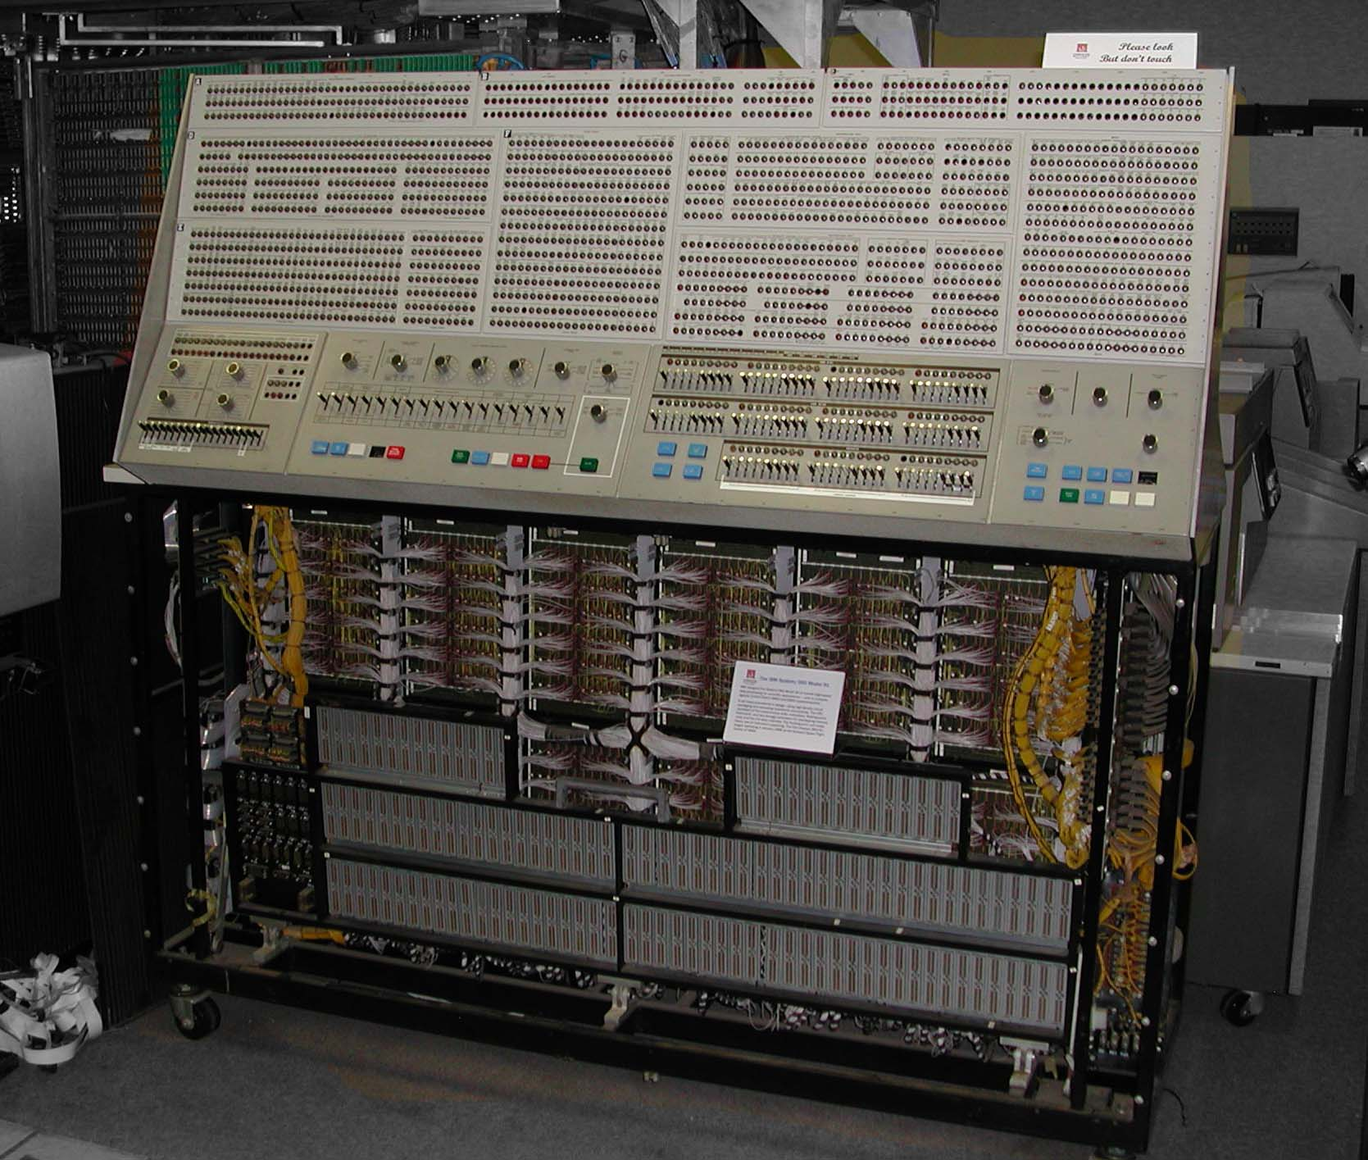
The Front Panel of System 360 Model 91

Slide 3
Tomasulo Organization
From Mem
FP Op
Queue
FP Registers
Load Buffers
Load1
Load2
Load3
Load4
Load5
Load6
Store
Buffers
Add1
Add2
Add3
Mult1
Mult2
Reservation
Stations
To Mem
FP adders
FP multipliers
Common Data Bus (CDB)

Slide 4
Fields of Reservation Stations
Op: The operation to perform
Vj, Vk: value of the source operands
Only one of V or Q is valid for each operand
Qj, Qk: RSs producing source registers
Qj, Qk = 0 => ready
Busy: indicates this reservation station and its accompanying FUs are occupied

Slide 5
Register File Has a Field
Qi: the reservation station that contains the operation whose result should be stored into this register
If the value of Qi is blank (0), no currently active instruction is computing a result for this register (where is the value?)

Slide 6
Load And Store Buffers
Each have a filed A
A: hold the effective address
The store buffer also has a V field
V: value of the operands

Slide 7
How It Works: Previous Example
L.D F6, 34(R2)
L.D F2, 45(R3)
MUL.D F0, F2, F4
SUB.D F8, F2, F6
DIV.D F10, F0, F6
ADD.D F6, F8, F2

Slide 8
Latencies and Checking Points
Latencies
Load is 1 clock cycle
Add/sub is 2
Multiply is 10
Divide is 40

Slide 9
Tomasulo Example
Instruction stream
3 Load/Buffers
FU count
down
3 FP Adder R.S.
2 FP Mult R.S.
Clock cycle counter

Slide 10
Tomasulo Example Cycle 1

Slide 11
Tomasulo Example Cycle 2
Note: Can have multiple loads outstanding

Slide 12
Tomasulo Example Cycle 3
Note: MULT issued, registers are removed (“renamed”) in RSs
Load1 exec completing; what is waiting for Load1?

Slide 13
Tomasulo Example Cycle 4
Load2 exec completing

Slide 14
Tomasulo Example Cycle 5
Timer starts down for Add1, Mult1

Slide 15
Tomasulo Example Cycle 6
Issue ADDD here despite name dependency on F6?

Slide 16
Tomasulo Example Cycle 7
Add1 (SUBD) completing; what is waiting for it?

Slide 17
Tomasulo Example Cycle 8

Slide 18
Tomasulo Example Cycle 9

Slide 19
Tomasulo Example Cycle 10
Add2 (ADDD) completing; what is waiting for it?

Slide 20
Tomasulo Example Cycle 11
Write result of ADDD here?
All quick instructions complete in this cycle!

Slide 21
Tomasulo Example Cycle 12

Slide 22
Tomasulo Example Cycle 13

Slide 23
Tomasulo Example Cycle 14

Slide 24
Tomasulo Example Cycle 15
Mult1 (MULTD) completing.Who is waiting?

Slide 25
Tomasulo Example Cycle 16
Just waiting for Mult2 (DIVD) to complete

Slide 26
Tomasulo Example Cycle 16-54
Faster than light computation (skip a couple of cycles)

Slide 27
Tomasulo Example Cycle 55

Slide 28
Tomasulo Example Cycle 56
Mult2 (DIVD) is completing. Who is waiting?

Slide 29
Tomasulo Example Cycle 57
In-order issue, o-o-o exec and o-o-o completion.

Slide 30
The Code
LOOP: L.D F0,0(R1)
MUL.D F4,F0,F2
S.D 0(R1),F4
DADDUI R1,R1,#-8
BNE R1,R2,LOOP

Slide 31
Predict
All branches are taken!
The reservation stations will allow multiple executions of the loop
The loop is unrolled dynamically by the hardware

Slide 32
Snapshot Time Assume
All of the instructions in two successive iterations of the loop have issued
But none has completed
The load and store buffers contain the addresses to be loaded from and stored to
The load values are in the load buffers
The store buffers indicate that the multiply destinations are the values to store

Slide 33
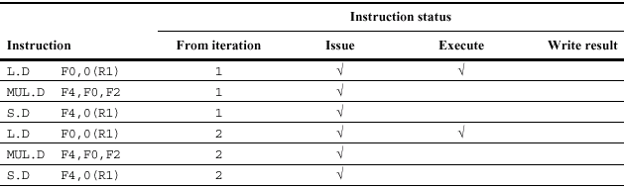
Instruction Status

Slide 34
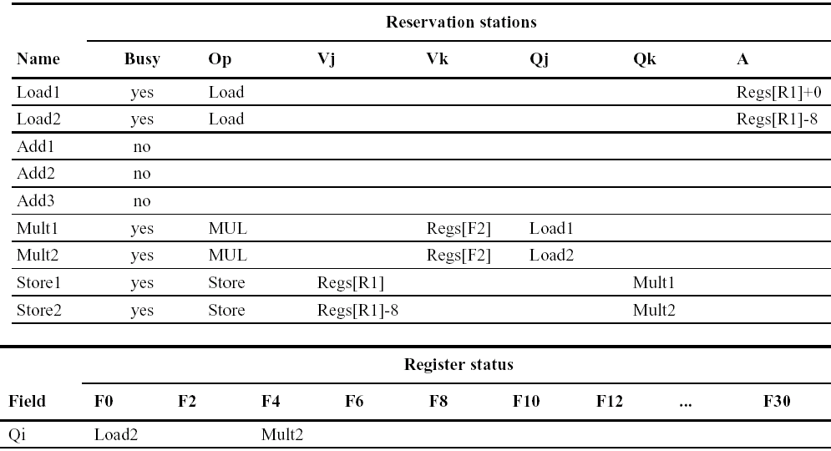
Status of FUs and Registers

Slide 35
Homework
Textbook: algorithms and execution evaluation
3.4~3.5
Papers
"An Efficient Algorithm for Exploiting Multiple Arithmetic units", Tomasulo, IBM Journal, January 1967
"Decoupled Access/Execute Computer Architectures", Smith, ISCA 1982 (ACM TOCS version)

